Slide 1
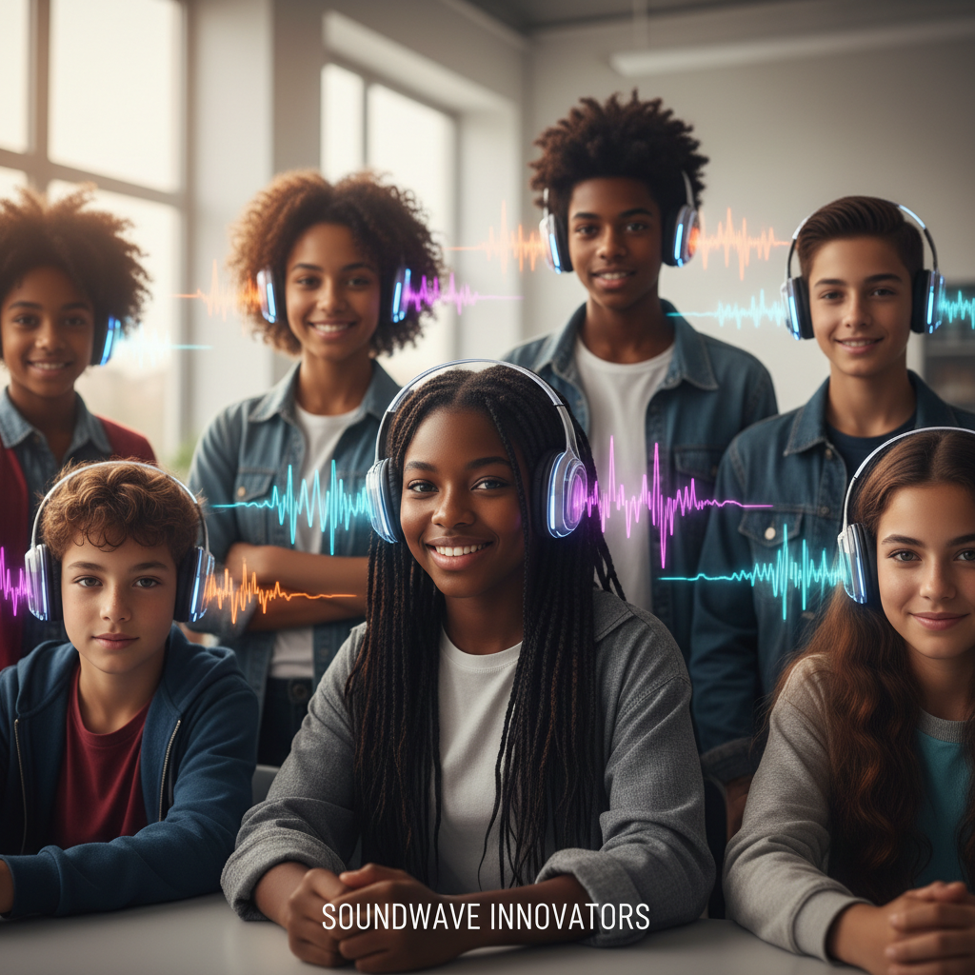
ModelIt!
Student Lesson
Your Music Is a Wave
How Sound, Light, and WiFi All Follow the Same Rules
NGSS: MS-PS4-1, MS-PS4-2
8th Grade
1/9

Slide 2
What You Will Learn Today
Learning Goals
* Explain the relationship between wave properties (amplitude, frequency, wavelength)
* Model how changing amplitude and frequency affects the energy and pitch of sound
* Predict how waves behave when they encounter different materials
* Evaluate real-world applications of wave science in music and technology
Key Vocabulary
Amplitude
The height of a wave — determines loudness in sound and brightness in light
Frequency
How many wave cycles per second (Hz) — determines pitch in sound and color in light
Wavelength
The distance between two identical points on consecutive waves
Medium
The material through which a wave travels — can be air, water, solid, or vacuum (for light)
2/9

Slide 3
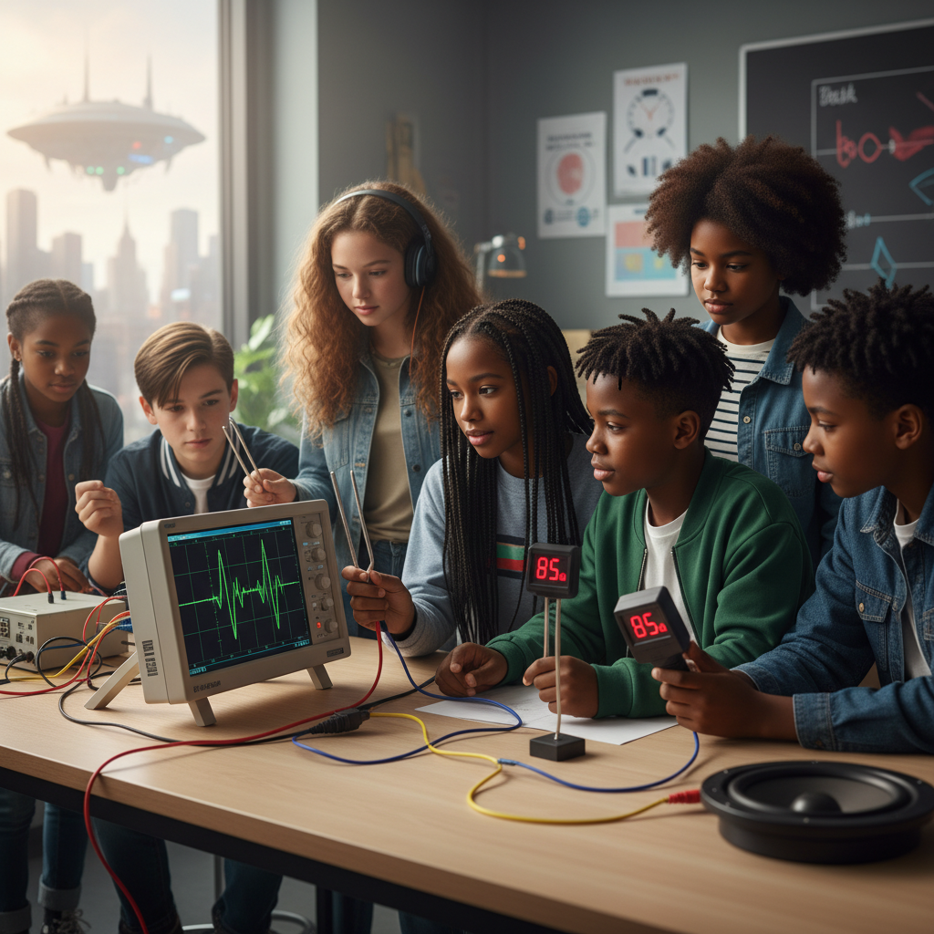
The Big Question
How does a wave carry your favorite song from a speaker to your ear?
How Sound, Light, and WiFi All Follow the Same Rules. Today we'll build a MODEL to discover the answer!
3/9

Slide 4

Today We Will Build a Model!
A model helps us understand complex systems!
1. LOCATE
Identify the COMPONENTS (parts) of the system
2. ESTABLISH
Connect them with RELATIONSHIPS (+ or -)
3. VISUALIZE
Build your model in ModelIt!
4. EVALUATE
Run SIMULATIONS to test scenarios
5. REVISE
Improve your model based on evidence
4/9

Slide 5
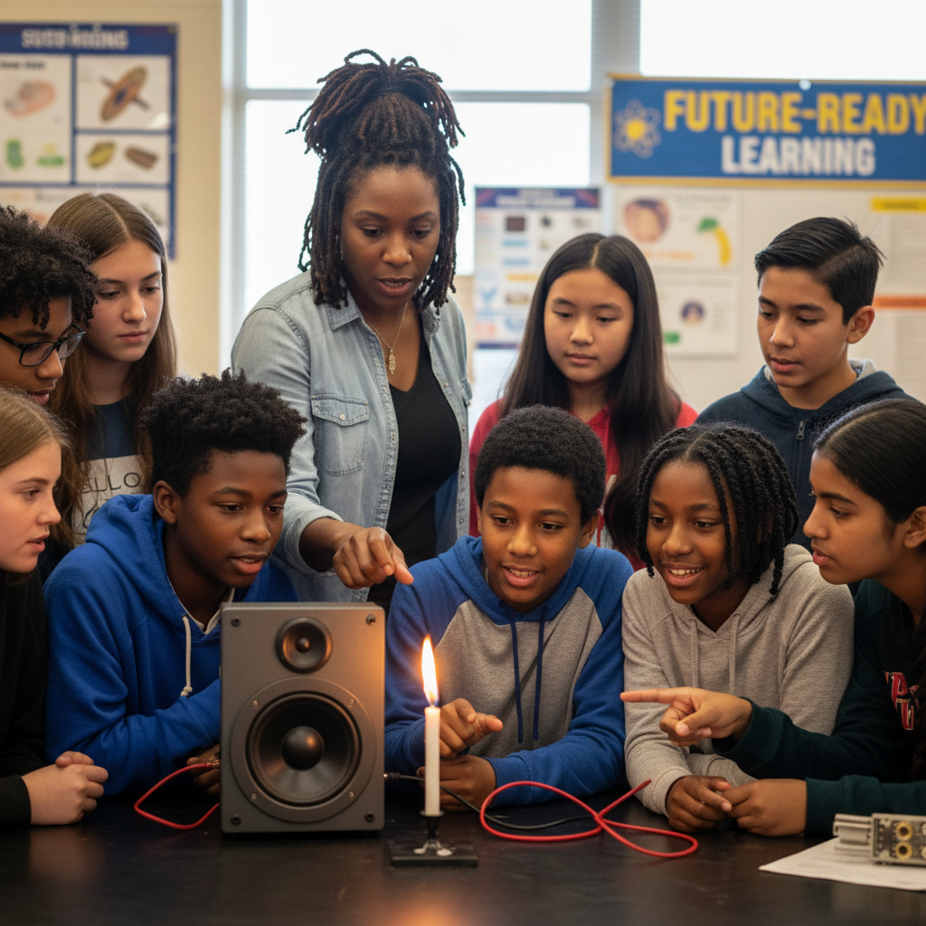
Activity 1: Sort the Components
Sort these components into EXTERNAL (inputs from outside) and INTERNAL (inside the system):
Your Components:
* Wave Amplitude
* Wave Frequency
* Wave Energy
* Sound Perception
Think: Which components can we control? Which happen on their own?
5/9

Slide 6
Activity 2: Connect with Arrows
Draw arrows to show HOW components affect each other:
(+) POSITIVE Relationship
When one goes UP, the other goes UP too
(-) NEGATIVE Relationship
When one goes UP, the other goes DOWN
Think About It:
When you turn the volume UP on your speaker, what wave property are you changing? When you play a higher note, what changes?
6/9

Slide 7
Activity 3: Run the Simulation!
Test these scenarios in ModelIt!
Whisper
Set Amplitude to low and Frequency to medium
Screaming High Note
Lock Amplitude AND Frequency to maximum
Bass Drop
Set Amplitude to maximum but Frequency to minimum
Watch the activity graphs change!
[ModelIt Platform Screenshot - Simulation Results Graph]
7/9

Slide 8
What Did We Discover?
Our Model Showed Us:
* Amplitude controls LOUDNESS — bigger waves carry more energy
* Frequency controls PITCH — more cycles per second = higher pitch
* Doubling the amplitude QUADRUPLES the energy (squared relationship!)
* Sound, light, radio, and WiFi are ALL waves following the same basic rules
Answer: Sound travels as a wave through the air. The speaker vibrates, creating pressure waves. The amplitude determines how LOUD (energy), and the frequency determines the PITCH. Your ear converts these waves back into signals your brain interprets as music!
8/9

Slide 9
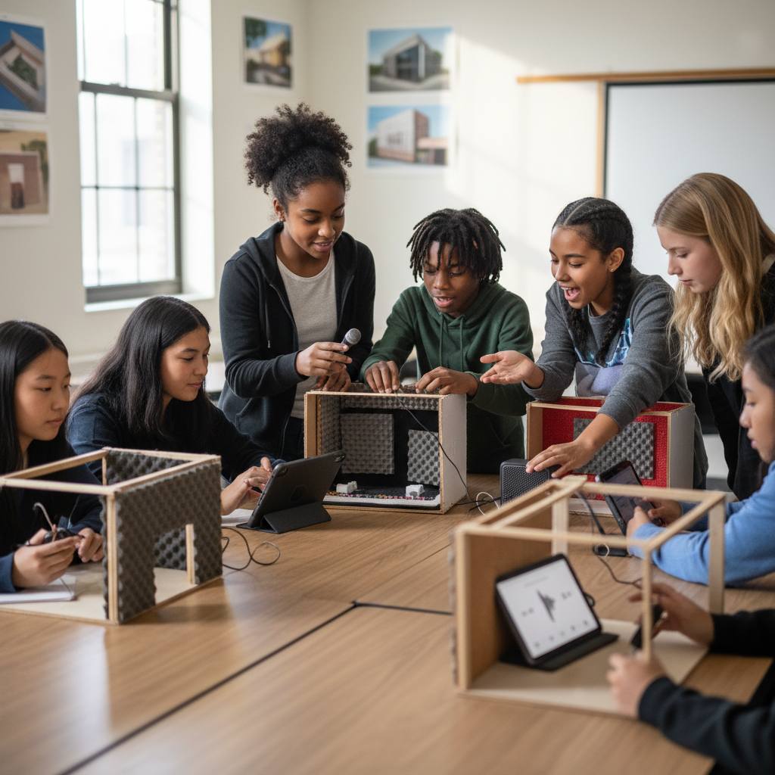
STEM Challenge: Design a Concert Venue
YOUR ENGINEERING MISSION
Design a concert venue or music room that optimizes sound quality using wave behavior principles.
The Challenge:
A music school needs a new performance hall. The architect hired your team to make science-based recommendations for materials and design to ensure great acoustics.
Think Like an Engineer:
* Which materials reflect sound? Which absorb it?
* How does room shape affect sound wave behavior?
* What causes echo and how can you control it?
REAL CAREER CONNECTION: Acoustical Engineers design concert halls, studios, and noise-canceling headphones. Audio Engineers produce music using wave science. They earn $60,000-$110,000/year. The skills you're using TODAY are the same ones they use on the job!
9/9

